Slide 1

What are we going to see in this session?
Why YAML ?
YAML Basics
Dictionary Representation

Slide 2
Why YAML
YAML – Yet Another Markup Language
We use YAML because it is easier for humans to read and write than other common data formats like XML or JSON.
We use .yml as an extension for configuration file or scripts written in YAML language.

Slide 3
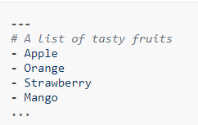
YAML Basics
All YAML files (regardless of their association with Ansible or not) can optionally begin with [---] and end with […]
This is part of the YAML format and indicates the start and end of a document.
Example :
Here you can see all the members of a list are eventually beginning with a dash and a space “-”

Slide 4
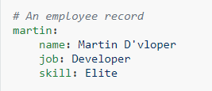
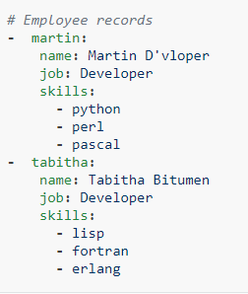
Dictionary Representation
Ansible allows you to represent dictionary format.
It can declare in very simple form key: value [The colon must be followed by a space]
In below example you can see how an employee record is represented in YAML.
Martine is an employee, and you can see how his details are registered dictionary format.
More complicated data structure are also possible.

Slide 5

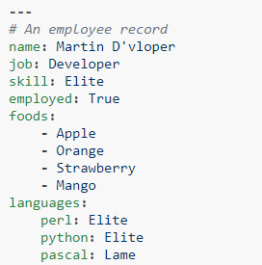
Cont.
Dictionaries and lists can also be represented in an abbreviated form if you really want it to be.
We can also use Boolean values(true/false) in several forms.
You can see the complete combinations below of what we have learned so far.

Slide 6

End of this topic !
Any questions?

